Slide 1

Nutrition Fact for
McDonald’s Menu

Slide 2
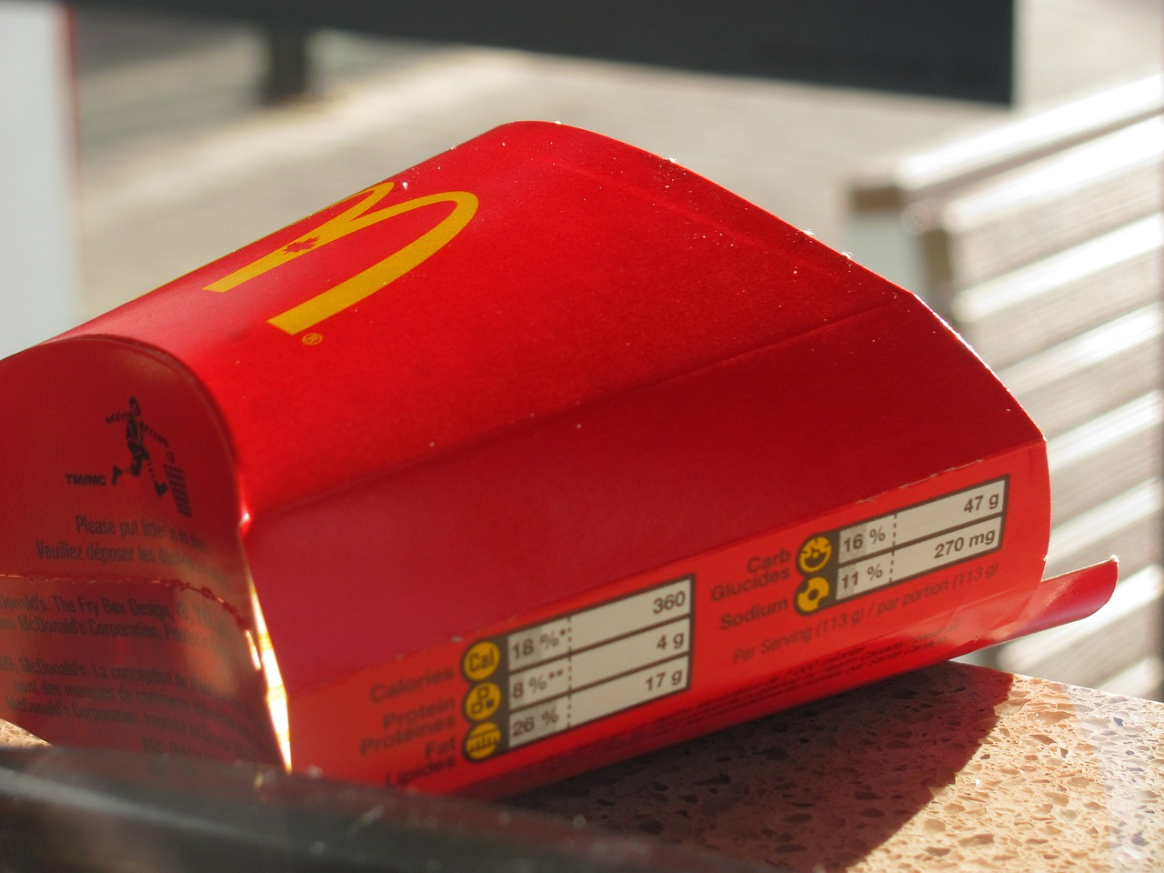
A. How many calories does the average McDonald's value meal contain?

Slide 3
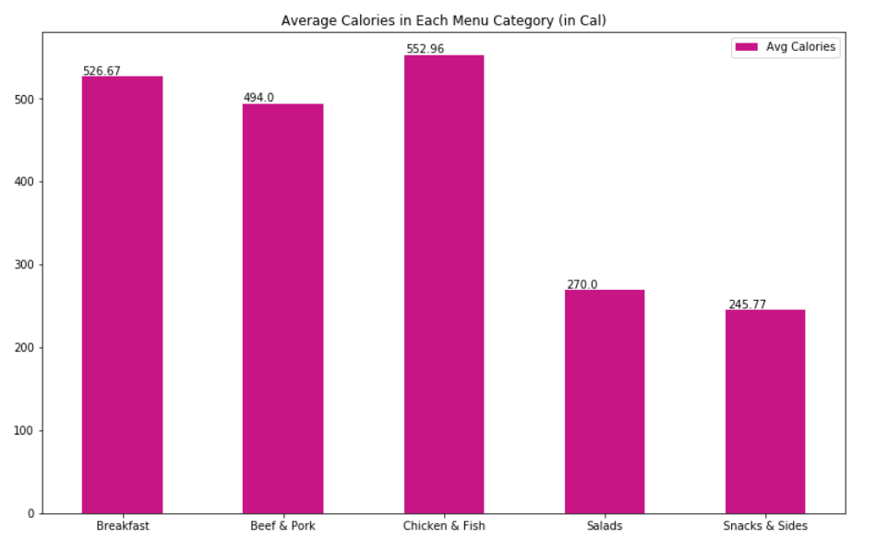
Average Calories in Meal Category
Beef & Pork 494.00
Breakfast 526.67
Chicken & Fish 552.96
Salads 270.00
Snacks & Sides 245.77

Slide 4

B. How much do beverages, like soda or coffee, contribute to the overall caloric intake?

Slide 5
Average Calories Of Soda
Average calories of Soda is 105.26
Averagely Soda contributes to men's calories intake for 0.04
Averagely Soda contributes to women's calories intake for 0.05

Slide 6
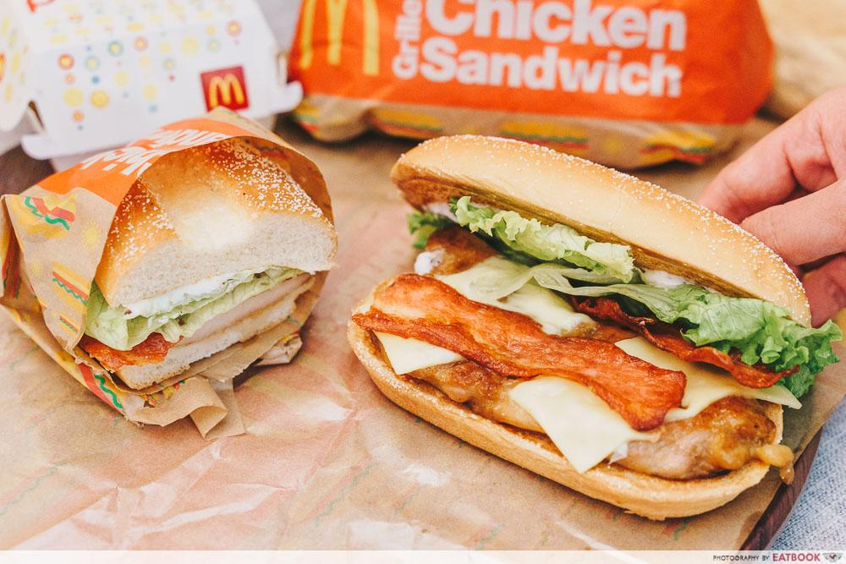
C. Does ordered grilled chicken instead of crispy increase a sandwich's nutritional value?

Slide 7
Nutritional value Crispy Chicken and Grilled Chicken
avg | Crispy Chicken | Grilled Chicken
Calories | 520 cal | 387 cal
Cholesterol | 58 mg | 75 mg
Sodium | 1148 mg | 1019 mg
Dietary Fiber | 9 g | 8 g
Sugar | 2 g | 3 g
Fat | 38%DV | 21%DV
avg | Crispy Chicken | Grilled Chicken
Carbohydrates | 16%DV | 12%DV
Iron | 16%DV | 16%DV
Calcium | 17%DV | 16%DV
Vit A | 39%DV | 43%DV
Vit C | 14%DV | 16%DV
Protein | 25 g | 29 g
Notes:
Yes, It does. Ordered Grilled Chicken instead of Crispy Chicken, increase a sandwich's nutritional value.
Grilled Chicken Category has more nutritional values in terms of the average amount of Cholesterol, Dietary Fiber, Vitamin A & C, Iron, and Protein than menu items in Crispy Chicken Category.

Slide 8

D. What about ordering egg whites instead of whole eggs?

Slide 9
Nutritional value Egg Whites and Whole Eggs
avg | Egg Whites | Whole Eggs
Calories | 565 cal | 537 cal
Cholesterol | 42 mg | 150 mg
Sodium | 1434 mg | 1336 mg
Dietary Fiber | 3 g | 3 g
Sugar | 8 g | 7 g
Fat | 44%DV | 44%DV
avg | Egg Whites | Whole Eggs
Carbohydrates | 18%DV | 16%DV
Iron | 15%DV | 17%DV
Calcium | 17%DV | 19%DV
Vit A | 4%DV | 8%DV
Vit C | 4%DV | 4%DV
Protein | 24 g | 23 g
Notes:
Yes, it does. Ordered Egg Whites instead of whole egg, increase a nutritional value.
Egg Whites Category has more nutritional values in terms of the average amount of Sugars, Dietary Fiber, Fat, Carbohydrates and Protein than menu items in While Egg Category.

Slide 10

E. What is the least number of items could you order from the menu to meet one day's nutritional requirements?

Slide 11
ASSUMPTION
Daily Calorie Intake is 2000
Daily Totalfat Intake 20% to 35%
Daily Protein Intake is 46 grams
Daily Carbohydates Intake is between 225 and 325 grams

Slide 12
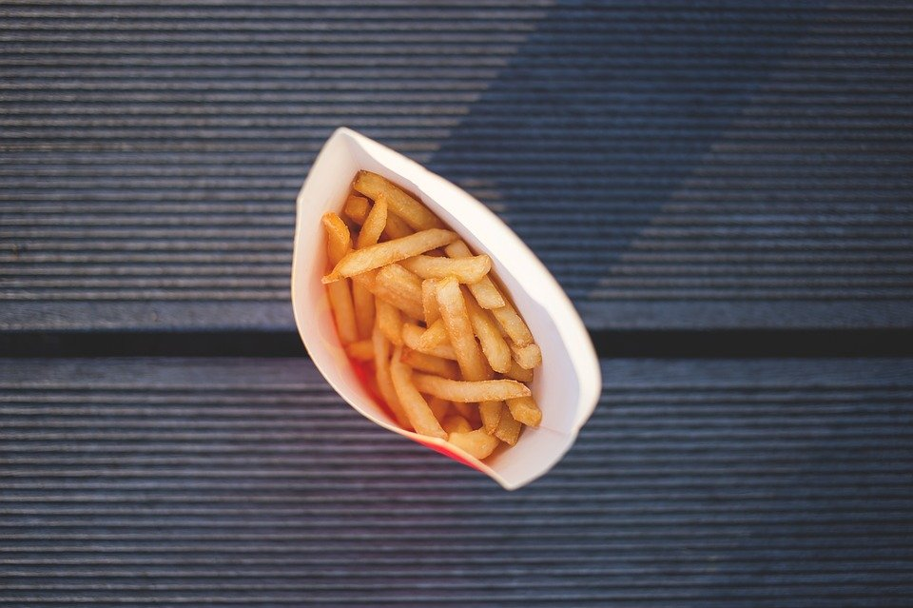
To meet the daily intake of calories, you can just order 1 Chicken McNuggets (40 piece) with 1880 cal.
To meet the daily intake of Total Fat, you can just order 1 Sausage Biscuit with Egg (Regular Biscuit) with 33%DV.
To meet the daily intake of protein, you can just order 1 Chicken McNuggets (20 piece) with 44 g.
To meet the daily intake of carbohydrates, you can just order 1 Chocolate Shake (Large) with 141 g, 1 Strawberry Shake (Large) with 140 g, with total of 281 g.

Slide 13
THANKYOU!

